Slide 1

DIGITAL HUMANITIES
GEOGRAPHY OF DIGITAL HUMANITIES CENTRES
PRESENTER: FARAI BELIEVE ZVIDZAI

Slide 2

WHAT IS DIGITAL HUMANITIES?
Matthew G. Kirschenbaum noted that, ‘The Digital Humanities, also known as humanities computing, is a field of study, research, teaching, and invention concerned with the intersection of computing and the disciplines of the humanities. It is methodological by nature and interdisciplinary in scope. It involves investigation, analysis, synthesis and presentation of information in electronic form. It studies how these media affect the disciplines in which they are used, and what these disciplines have to contribute to our knowledge of computing.’

Slide 3
This presentation attempts to provide a critical map of the main initiatives, organizations and centers scattered across various continents. Rather than attempt to define DH outright, this presentation provides a brief survey of professional associations, the location and makeup of DH centres around the world.

Slide 4
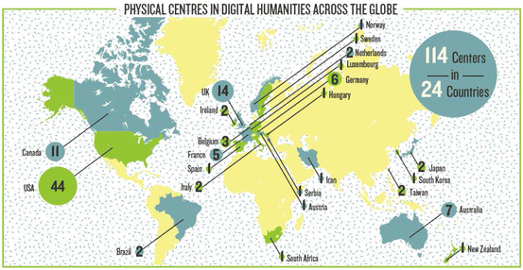

Slide 5
A centre is roughly defined as a group of scholars within a given community or academic institution, who are devoted, at least in part, to digital humanities research. The centre may conduct its own research projects or may provide technical support to academic projects across several schools. The majority of centres are housed in colleges and universities, although some are funded by governments or private initiatives.

Slide 6
It is our hope that this overview will clarify many questions about who works in the digital humanities and what it is that they do. The Alliance of Digital Humanities Organizations (ADHO) is a global umbrella organisation, which ‘promotes and supports digital research and teaching across all arts and humanities disciplines, acting as a community-based advisory force, and supporting excellence in research, publication, collaboration and training’. ADHO is currently comprised of a number of regional professional organisations and has approximately 400 members worldwide (Humanities World Report 2015).

Slide 7
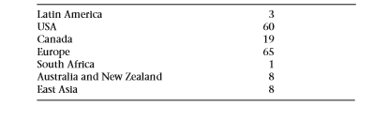
The table below summarises the number of digital humanities centres around the world according to information provided by centerNet, a global coalition of DH centres. The list is not complete, but is a good approximation of the reality at the time of compilation in July 2013

Slide 8
AFRICA
SOUTH AFRICA
By way of illustration centerNet reports one DH centre in South Africa, the University of Cape Town Center for Educational Technology. It is worth noting that the Rhodes University Book and Text Studies programme has held workshops in Humanities Computing. Additionally, the eThekwini Municipality’s Libraries and Heritage Department in Durban, South Africa maintains a cultural heritage project, intended ‘to collect and disseminate local content, in English and Zulu’.

Slide 9
ZIMBABWE
There is only one DH centre in Zimbabwe, the University of Zimbabwe. It is worth noting that the DH program is under the Department of History, Heritage and Indigenous Knowledge Systems, contemporarily with two lecturers and five students precisely being the pioneers of the program.

Slide 10
AUSTRALIA AND NEW ZEALAND
There are at least 7 DH centres in Australia, the ANU DH Hub being among the largest, housing five permanent staff members, and nine affiliated faculty. There is a least one centre in New Zealand, the New Zealand Electronic Text Centre.

Slide 11
ASIA
JAPAN
There are three DH centres in Japan, including the University of Tokyo Center for Evolving Humanities, The Ritsumeikan University Digital Humanities Center for Japanese Arts and Cultures, and the International Institute for Digital Humanities (DHII). Taiwan is home to the Nanyang Technological University Research Centre for Digital Humanities (NTU) and the Dharma Drum Buddhist College Library and Information Center. A number of these centres have a strong interest in preserving and disseminating local historical and cultural information.

Slide 12
CHINA
In China, there are several academic departments with a strong interest in DH. The Fudan University Research Center on History and Geography, the Wuhan University History College, the Nanjing Normal University and the Chinese Academy of Social Sciences have developed digital projects concerning Chinese geography and ancient archival materials.

Slide 13
EUROPE
ENGLAND
Europe has at least 65 DH centres. The densest concentration of 19 centres is in England, the largest being the University College London Centre for Digital Humanities with six directors, ten staff, student, and liaison positions, ten affiliated faculty, and 13 or more affiliated graduate students.

Slide 14
IRELAND
Ireland has the world’s largest structured PhD programme in digital arts and humanities in a consortium of six universities, north and south of the border, with more than 60 doctoral students.

Slide 15
OTHER CENTRES IN THE CONTINENT
There are at least 38 centres on the Continent, with strong representation in countries like the Netherlands, France, Germany, Denmark, Sweden, Italy and Austria.

Slide 16
AMERICA
UNITED STATES OF AMERICA (USA)
There are approximately 60 DH centres in the United States with world-leading facilities, such as the Massachusetts Institute of Technology HyperStudio, the Harvard University Digital Arts and Humanities (DARTH), the Columbia University Digital Humanities Center (DHC), the University of Maryland Institute for Technology in the Humanities (MITH), George Mason University’s Center for History and New Media (CHNM), and many other centres, indicating a vigorous growth of this field at most North American humanities faculties.

Slide 17
CANADA
centerNet reports 19 DH centres in Canada, ranging in size from one permanent faculty director, with five appointed scholars (CIRCA) to seven staff and faculty positions and 40 affiliated faculty (DH McGill). As the largest of these, the initiative at McGill is shared between the Faculties of Arts, Religious Studies, Music, and the Library. Its projects tend to focus on textual analysis, knowledge environments, spaces and publics, cultural archives, curation, and visualisation.

Slide 18
MEXICO
It should be noted that a large university like the National Autonomous University of Mexico (UNAM) does not have a single, unified DH centre but does have many ‘small personal initiatives’. Recent findings show that there are at least 20–30 self-identified digital humanists working in four Mexico City universities. This illustrates both the relative lack of information about the DH community in Mexico and other parts of the Spanish-speaking world.

Slide 19


